Slide 1

Online video sharing and social media platform
BACKEND MICROSERVICES PROJECT Using Nest JS MONOREPO

Slide 2
Business Requirements
Build an online video sharing and social media platform like YouTube.
MVP
Login
Video upload
Video search
Video browse
Subscription

Slide 3
Monorepo Application
NestJS framework has been used in monorepo mode, to create and manage the codebase for multiple microservices in a single version control repository.
Benefits:
Simplified code sharing and reuse.
Easier dependency management.
Streamlined development and testing processes.
Single DockerFile with multi-stage build for each microservice.

Slide 4
Microservices
Microservices is an architectural style where a large application is broken down into smaller, loosely coupled services that communicate via APIs.
Benefits:
Scalability: Each microservice can be independently scaled.
Flexibility: Enables different teams to work on different services.
Resilience: Failure of one service doesn't affect the entire system.

Slide 5

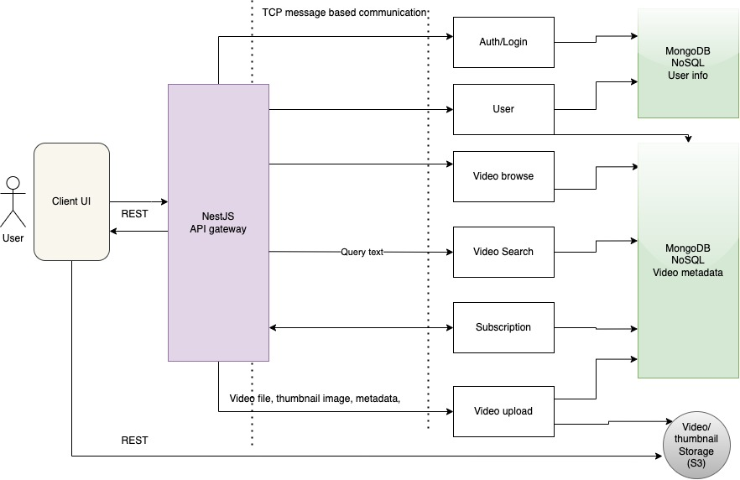
Architecture Diagram

Slide 6
Application components
API Gateway (vid-gateway)
Built using NestJS.
Encapsulates all the microservices and serves as the primary interface for the entire application
All the external HTTP requests pass through it and are then routed to the designated recipient microservice.
It also serves the intercommunication amongst the microservices using the TCP based message communication.
Auth/Login Service
It is a microservice, which allows the user to sign-up, as well as login using the username and password,
Once the user is validated, it provides the access token to the client, encoded in JWT token
It also performs the validation of JWT, which is requested by each microservice for every incoming request from UI.
User Service
It allows the UI to fetch basic user profile data from the database.

Slide 7
Application components
Upload Service
It is a microservice to allow user to upload the video file as well as the thumbnail from the UI and save it to the storage (like S3) and save the reference path in the MongoDB
Browse Service
It is a microservice to allow user to fetch the thumbnails and metadata of all the videos stored in the database.
Search Service
It allows the user to find the video(s) based on search keywords or filters applied at the UI and return the video metadata and thumbnails
Subscription Service
It allows user to subscribe to a specific user, which in turn allows him/her to get notifies when the subscribed user uploads any new video.

Slide 8
Database
MongoDB Atlas is used to store user information and video metadata.

Slide 9
Deployment
Docker
A single Multi-stage DockerFile is created.
Each stage in the docker file creates the separate image for each service, by running:
docker build -t <image-name> -f Dockerfile --target <stage-name> .
Docker Desktop (for dev purpose)
A single docker-compose.yml is created, which creates a virtual docker network and deploysthe container for each service in it.
Running app & containers can be visualized in Docker Desktop

Slide 10
Deployment
Kubernetes
Minikube tool is used for Local Kubernetes deployment. Similar configuration can be used to deploy it in cloud services such as AWS EKS.
Separate Deployment yaml files have been created for each microservice, which can be applied using kubectl, in order to create and deploy them in their respective PODs.
As PODs in K8s cannot be accessed directly from outside, they are exposed using their respective K8s services.
Separate yaml files have been created from the respective service for each POD, which can again be deployed using kubectl apply.

Slide 11
Security
API gateway pattern is used to provide secured external access to each microservice.
OAuth2.0 is used for authorization. Access token is encoded in JWT. JSON Web Tokens (JWT) is an open standard for securely transmitting information between parties as a simplified JSON object.
How It Works:
User logs in and receives a JWT access token.
Token is included in subsequent API requests for authentication.
Server validates the token and grants access to protected resources.

Slide 12
Scalability
We can scale individual microservices based on demand to handle traffic efficiently.
Benefits of Horizontal Scaling: Improved performance and responsiveness during peak usage periods.

